Slide 1




TASK MANAGEMENT APPLICATION USING DOCKER
Name: Vivek Pandey
College: Ajay Kumar Garg Engineering College
Department: Cloud Computing
IBM Skillsbuild

Slide 2
AGENDA
Problem Statement
Objectives
Technology Stack
Project Architecture
Project Structure
Docker Workflow
Key Features
Live Demonstration
Challenges Faced
Learning Outcomes
Future Scope

Slide 3
PROBLEM STATEMENTS
In today's fast-paced environment, managing daily tasks efficiently is essential for improving productivity. Many users still rely on traditional methods such as handwritten notes or scattered digital applications, which can lead to disorganized workflows, missed deadlines, and reduced efficiency. Managing daily tasks manually becomes difficult when multiple activities need to be tracked. Existing methods such as paper notes or scattered applications are inefficient and may result in missed deadlines.
To address these challenges, this project presents a Docker-based Task Management Application. The application allows users to create, update, and delete tasks through a simple and responsive interface while Docker packages the application along with all its dependencies into a container.

Slide 4
OBJECTIVES
01.
02.
03.
Develop a user-friendly Task Management Application. Ensure platform-independent deployment
Implement CRUD operations
Create Task
Read Task
Update Task
Delete Task
Containerize the application using Docker. Learn cloud-native application development

Slide 5
TECHNOLOGY STACK
Technology Purpose
HTML Structure
CSS Styling
JavaScript Client-side Logic
Node.js Backend Runtime
Express.js Server Framework
Docker Containerization
Git Version Control
GitHub Repository Hosting

Slide 6
SYSTEM ARCHITECTURE
User
│
Web Browser
│
Express Server
│
Docker Container
│
Host Machine

Slide 7
WORKING ARCHITECTURE
User opens the application in the browser.
↓
Request reaches Express Server.
↓
Application runs inside Docker Container.
↓
Response is sent back to the user.

Slide 8
PROJECT ARCHITECTURE
public
├── css
├── js
└── index.html
├── server.js
├── package.json
├── Dockerfile
├── README.md
└── .dockerignore

Slide 9
DOCKER WORKFLOW
Application Code
↓
Dockerfile
↓
Docker Build
↓
Docker Image
↓
Docker Container
↓
Application Running

Slide 10
COMMAND USED
docker build -t task-management-app .
docker run -d -p 3000:3000 task-management-app
docker ps
docker stop <container-id>

Slide 11
KEY FEATURES
✔ Add New Tasks
✔ Edit Existing Tasks
✔ Delete Tasks
✔ Mark Tasks as Completed
✔ Responsive User Interface
✔ Fast Performance
✔ Dockerized Deployment

Slide 12
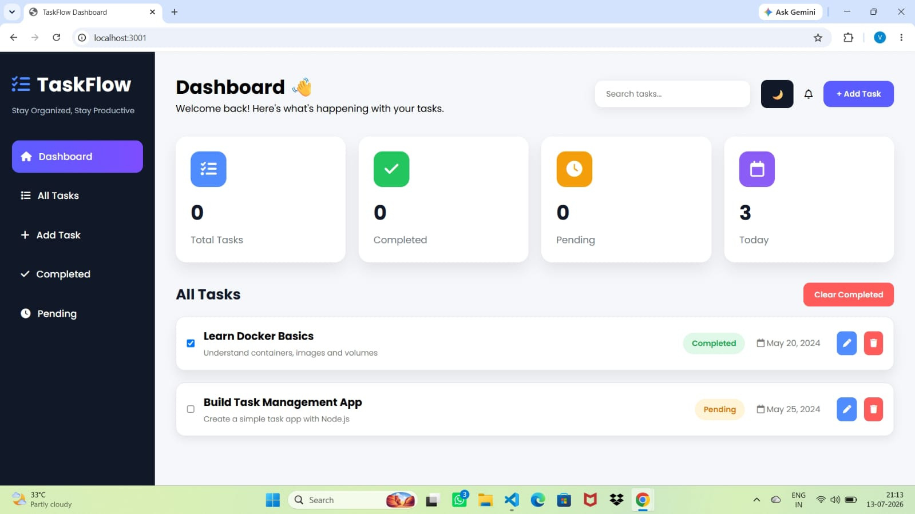
THERE ARE TWO MODES:
DEFAULT MODE
DARK MODE

Slide 13
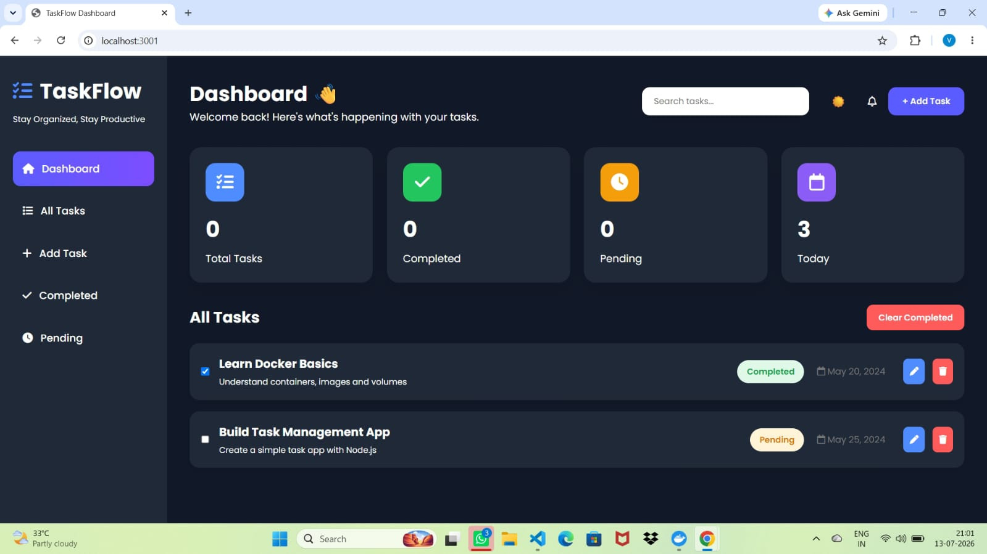

Slide 14
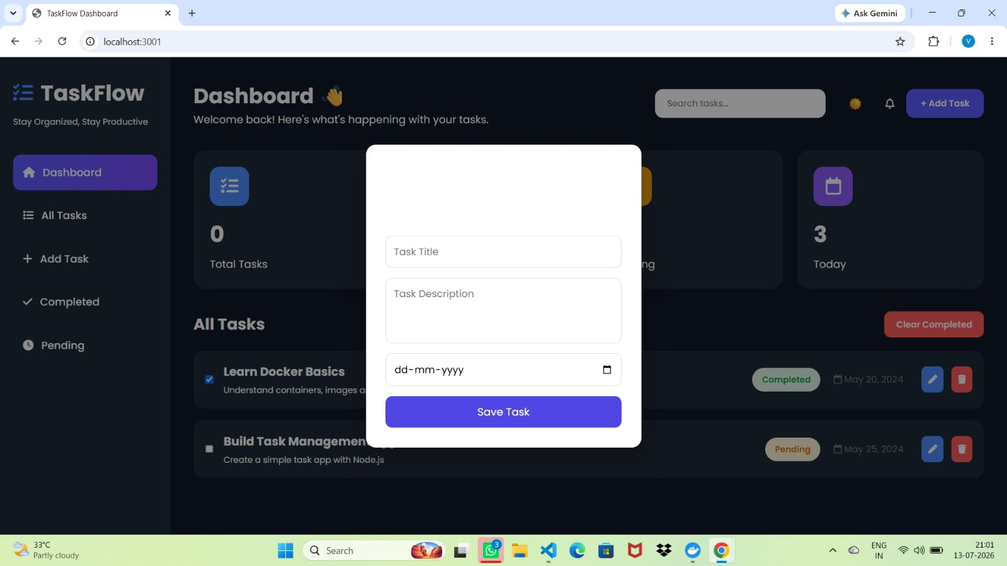

Slide 15
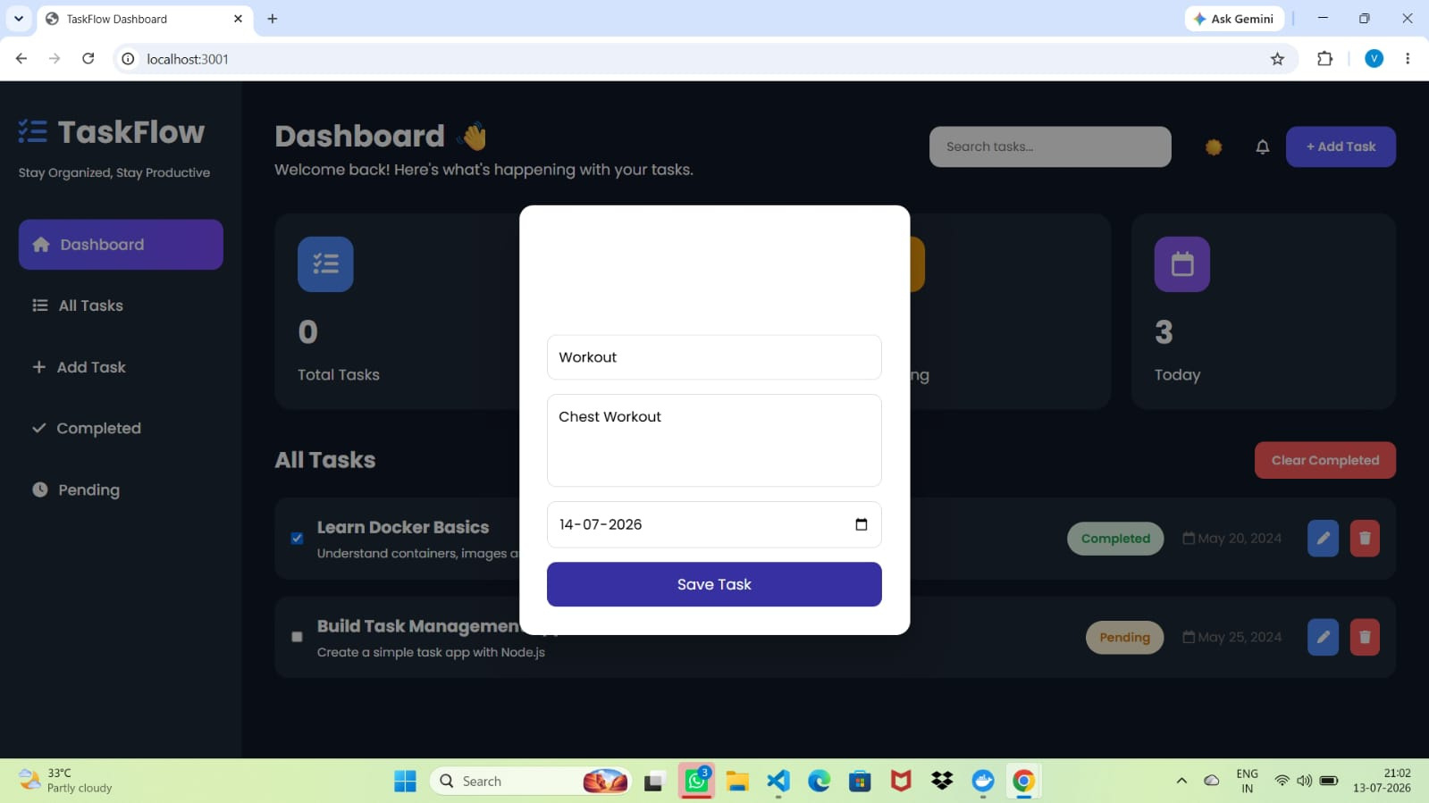

Slide 16
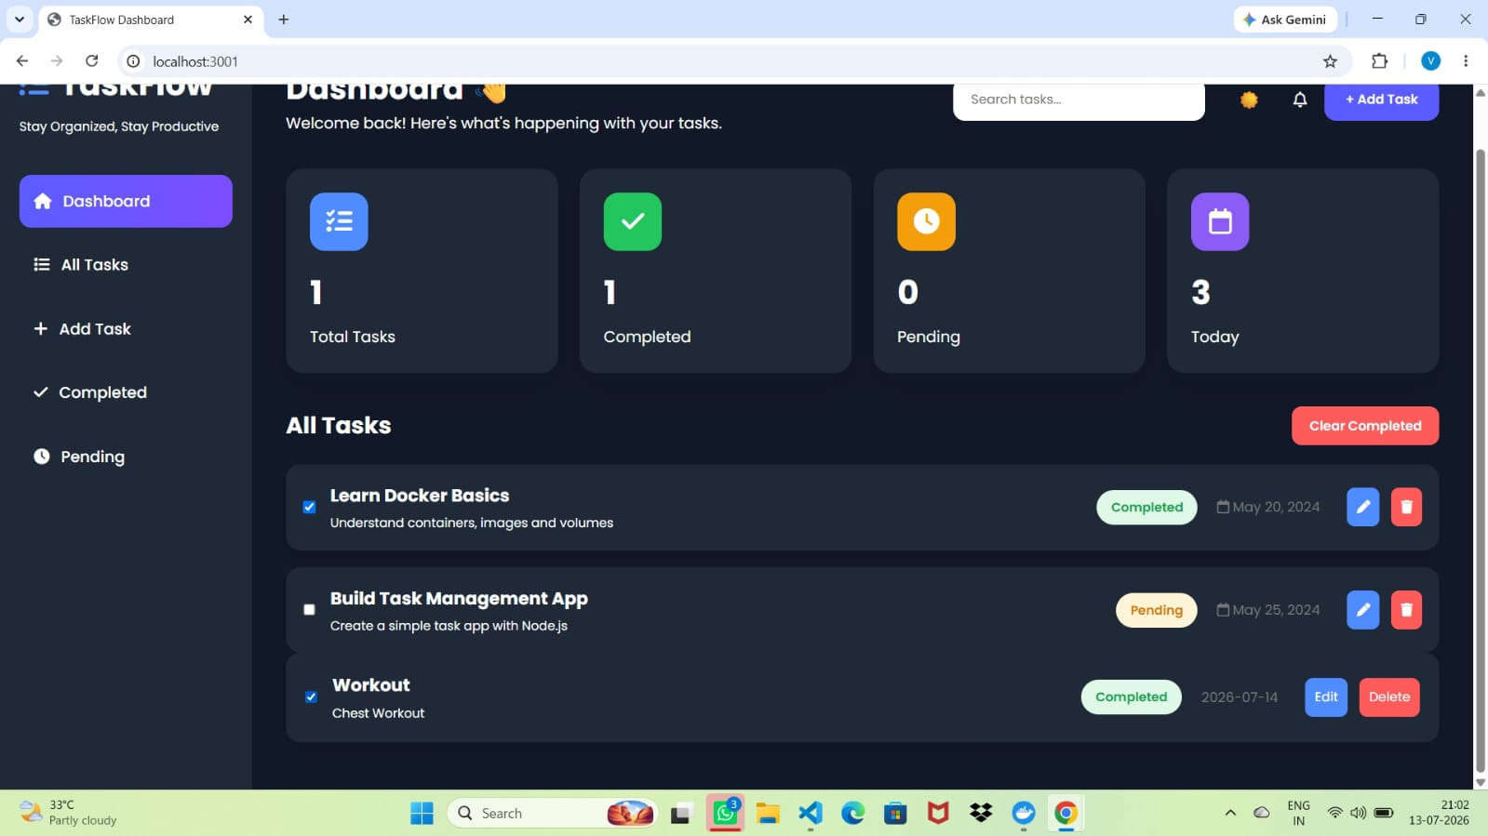
HERE TASK ARE REGISTERED.
AS YOU CAN SEE SOME ARE PENDING AND SOME ARE COMPLETED

Slide 17
CHALLENGES AND LEARNING
Challenges
Docker installation issues
Port conflicts
Container build errors
Debugging JavaScript
GitHub push issues
Solutions
Correct Docker configuration
Changed occupied ports
Verified Dockerfile
Fixed JavaScript errors
Managed Git commits properly

Slide 18
LEARNING OUTCOMES
✔ Docker Basics
✔ Docker Images
✔ Docker Containers
✔ Dockerfile
✔ Node.js with Express
✔ Git & GitHub
✔ Cloud Native Deployment

Slide 19

FUTURE SCOPE
Database Integration (MongoDB)
User Authentication
Due Date Reminders
Task Categories
Cloud Deployment (AWS/Azure)
Kubernetes
CI/CD Pipeline

Slide 20
THANK YOU

